Slide 1

DESIGN SHOWCASE CELEBRATION
2023
The AeroGrower
AEROPONIC MISTER

Slide 2

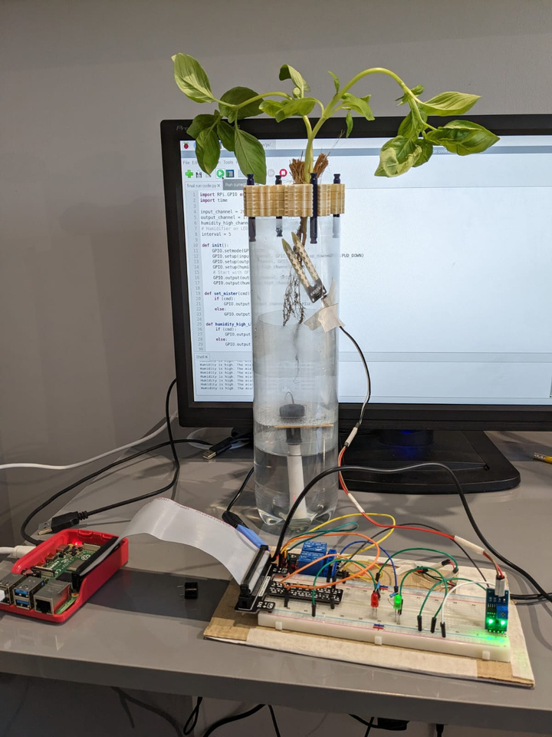

The aerogrower
Aerogrower
TECH DESIGN SHOWCASE 2023

Slide 3
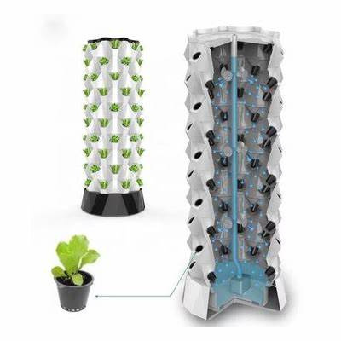
What is Aeroponics?
Aeroponics is the process of growing plants without a growth medium (such as soil), similar to Hydroponics the only difference is that Aeroponics has plant roots in air, which are then fed water and nutrients. Hydroponics, on the other hand is when the roots are placed in water. In a conventional aeroponics setup, the water an nutrients is either dripfed or sprayed onto the roots.
Aerogrower
TECH DESIGN SHOWCASE 2023

Slide 4
What are the benefits of aeroponics?
Saves up to 95% less land
98% less water
can be set up anywhere
can be grown closer to the consumer, prolonging life of produce
small scale
plants tend to be 2-3 times bigger
Helps the environment

Slide 5
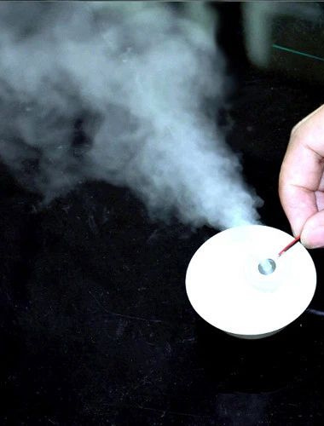
The Aerogrower
In the aerogrower I have used a piezoelectric disk instead of a sprayer to provide a mist, this means that plant roots can be placed anywhere in the chamber without the necessity of an additional mister as the mist reaches all areas of the chamber.

Slide 6
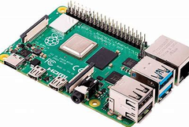
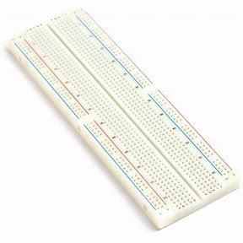
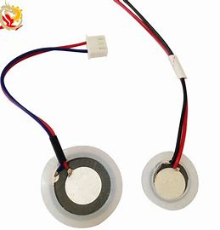
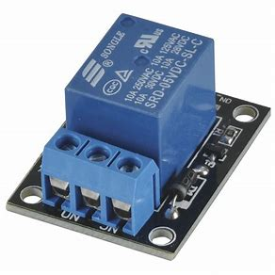
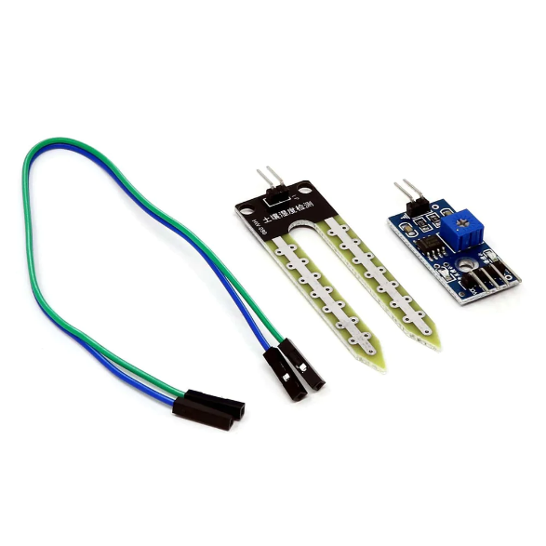
Components
Raspberry Pi
Bread Board
Piezoelectric Disc
5v Relay
Soil moisture Sensor

Slide 7
Setup
The plant roots are kept in a chamber where they are constantly exposed to air, a humidistat determines the amount of humidity. Under this chamber the water and nutrients solution is placed. An Ultrasonic Piezo electric disk (mister) is placed on top of the solution tank. Therefore it sprays its mist into the roots chamber.

Slide 8
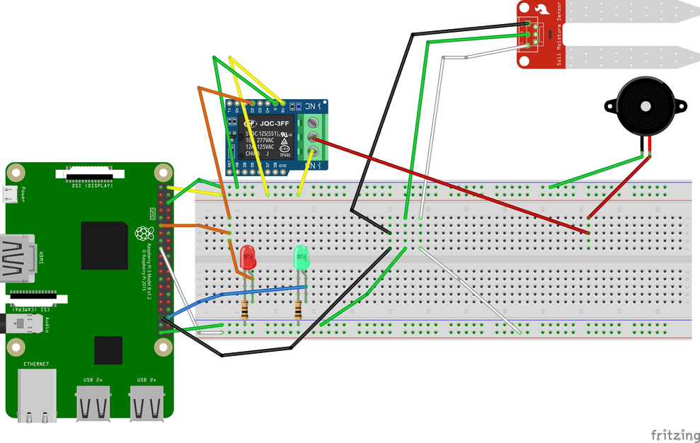
How does it work
The Raspberry Pi monitors the Humidity through the Humidistat.
When it detects a low amount of humidity, it turns ON the Piezo electric mister giving the plant the moisture and the nutrients that it needs.
When the humidity is back to required levels, it turns OFF the Piezo electric mister and thus stops providing the mist.

